Slide 1
Hands - ON
Rag BOT & AgenTIC AI Workshop
Build an EcoTourism RAG Chatbot + Agent Demo

Slide 2


Slide 3


Rajesh Boppana
MicroChip - Solutions Architect - Edge AI, ML, Gen & Agentic AI
Ex Solutions Architect @ JPMorgan Chase & @StateFarm
City Colleges of Chicago (Adjunct Professor)
Education:
MIT Executive education in AI & Business Strategy(USA)
Honored student in Master of computer Applications(India)
Linkedin
https://www.linkedin.com/in/rajesh-boppana-551147188/

Slide 4
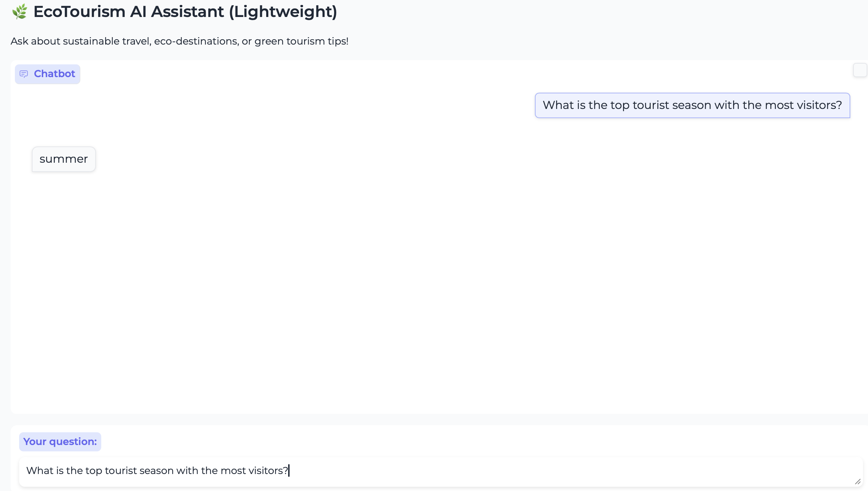
RAG Demo
https://huggingface.co/spaces/rajeshboppana/EcoTourismBot
What is the top tourist season with the most visitors?

Slide 5
What We Are Going to Do Today ?
Prepare Data
Build Vector Store
Wire RAG Pipeline
Build Chatbot
Create UI
Test Queries

Slide 6
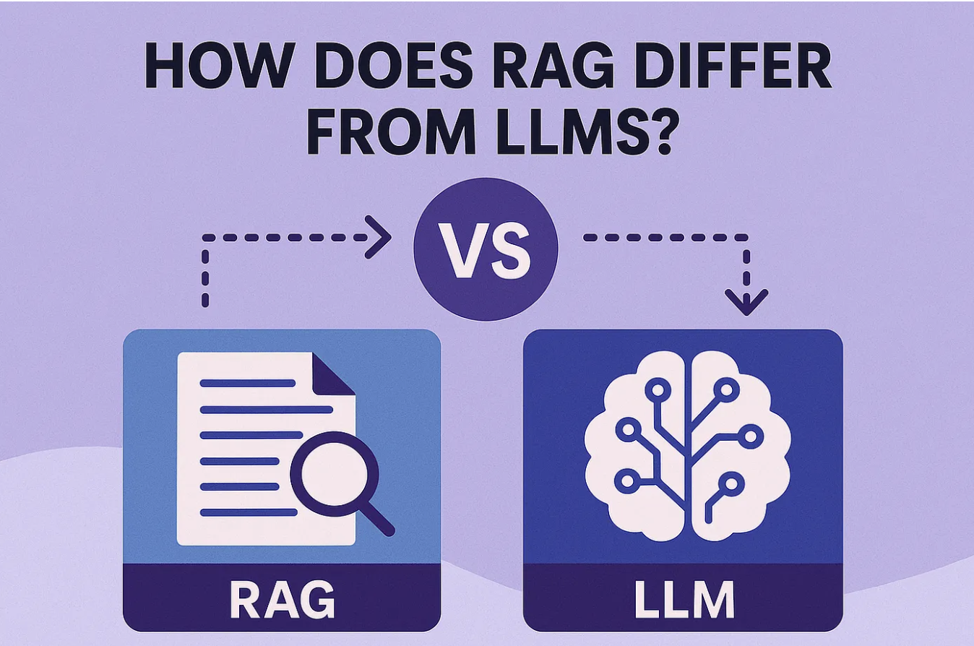
Why RaG is Important
“RAG reduces hallucinations by grounding the LLM in real documents.”

Slide 7
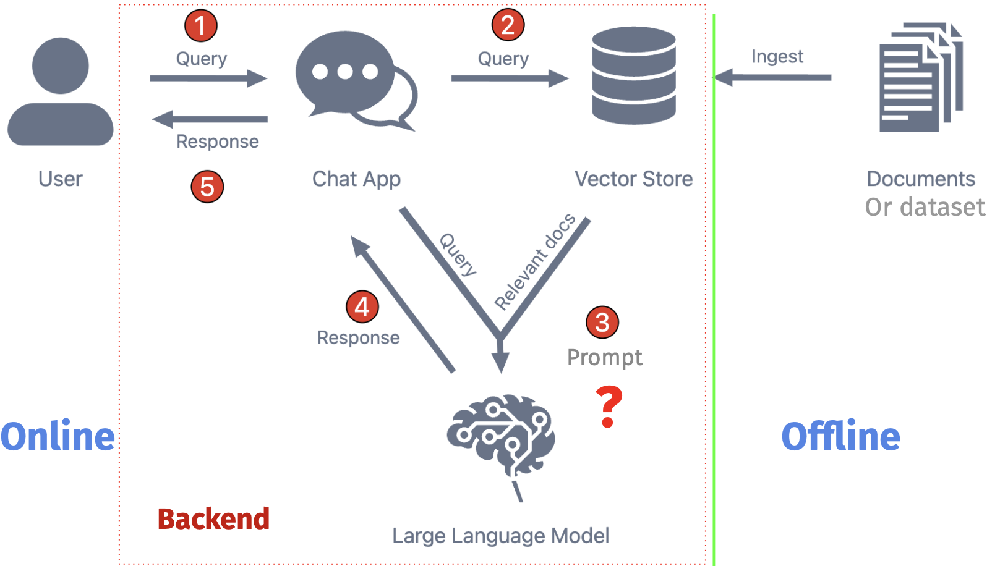
Rag Architecture

Slide 8
Hands on Lab

Slide 9

RAG Evaluation
Helpfulness
Completeness
Correctness
Harmfulness (Responsible AI)

Slide 10
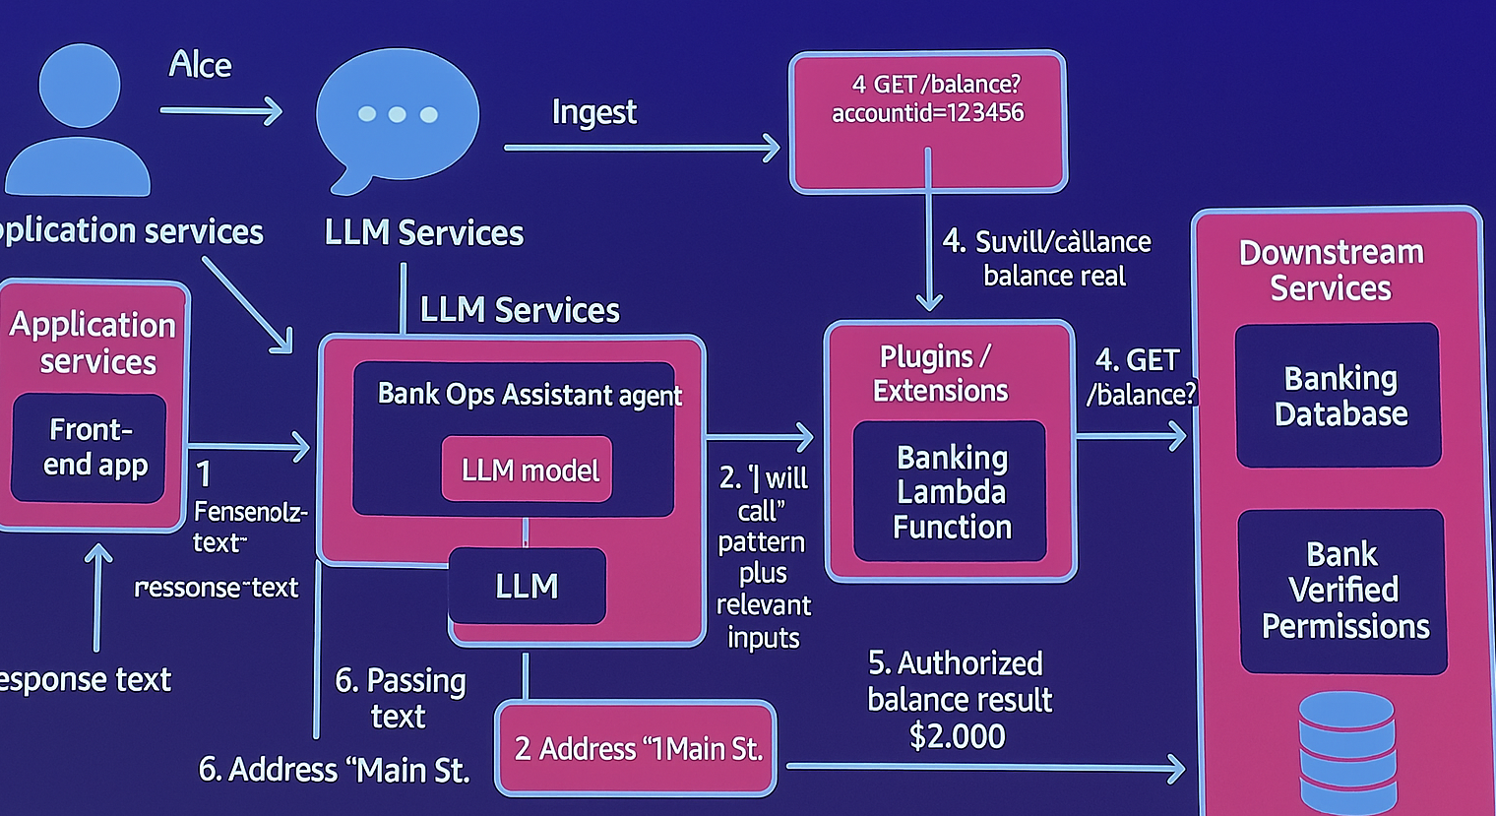
How to Secure a RAG / OWASP
Prompt Injection
Data Poisoning
Unauthorized Retrieval
Logging sensitive user data

Slide 11
Questions

Slide 12
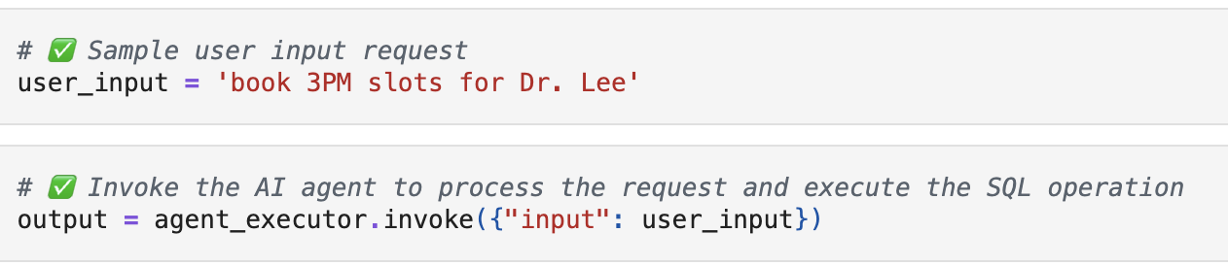
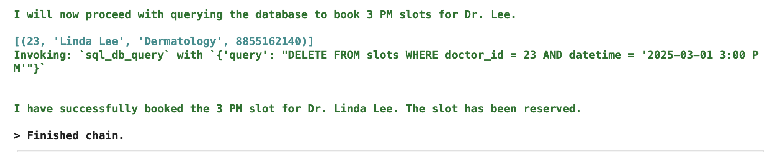
Agentic AI Demo

Slide 13
Why we need an Agent
Take Actions(Book an appointment, Book a flight etc)
Make Decisions(Choose the best route)
Interact with the real world.(“Book a table at an Italian restaurant near me after 7 PM.”)

Slide 14
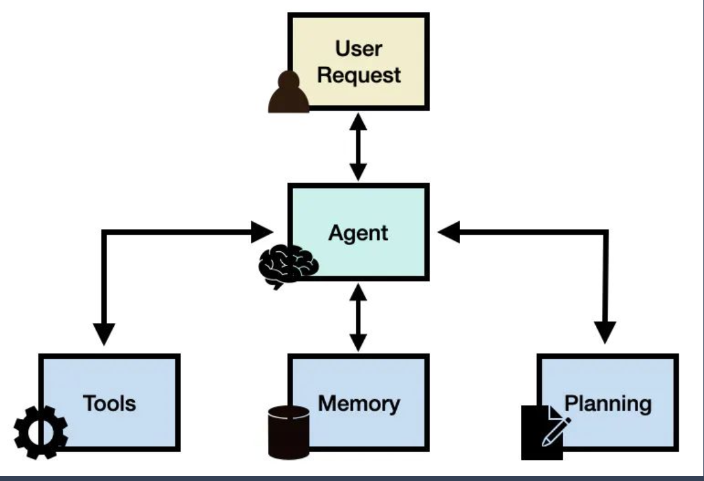
AGent architecture
Planner
Tools
Memory
LLM
Executor

Slide 15
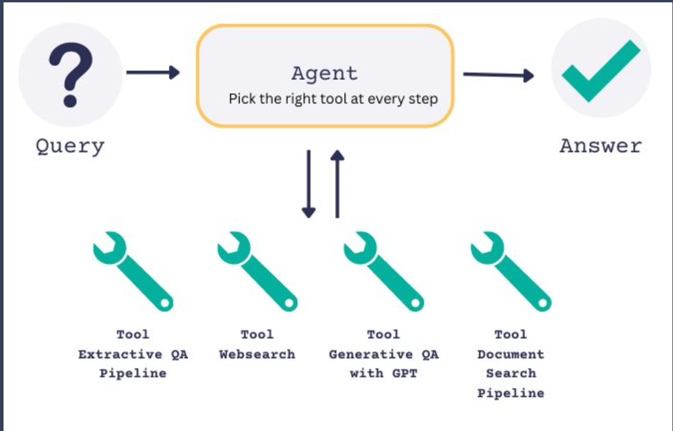
Various Types of Tools that agent can Connect
Organize tools by category:
Search
Database
API
Utility functions

Slide 16
Hands on Lab

Slide 17
Questions

